Slide 1
Data
Validation

Slide 2
Design Test

Slide 3
Completeness validation

Slide 4
Formatting Validation

Slide 5
Tables and Schema
Transaction Details:
Transaction_id: Unique identifier for each transaction.
Transaction_time: Timestamp indicating when the transaction occurred.
Transaction_type: Type of transaction (e.g., purchase, deposit, withdrawal).
Amount: Numeric field representing the transaction amount.
Category: Categorization of the transaction (e.g., groceries, utilities).
Mode: Mode of transaction (e.g., online, in-person).
Customer Information:
Customer_id: Identifier for the customer associated with the transaction.
Customer_firstname: First name of the customer.
Customer_lastName: Last name of the customer.
Customer_gender: Gender of the customer.
Date_of_birth: Date of birth of the customer.
Salary: Customer's salary or income level.

Slide 6
Tables and Schema
Account Details:
Account_Number: Account number linked to the transaction.
Status: Status of the account (active, closed, etc.).
Date_of_Creation: Date when the account was created.
Address and Location:
Address_zipcode: Zip code of the customer's address.
State: State where the customer resides.
City: City where the customer resides.
Street: Street address of the customer.
Recipient Information:
Recipient_id: Identifier for the recipient (if applicable).

Slide 7
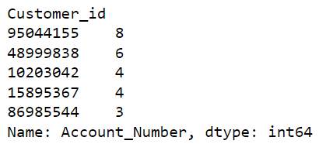
Univariate Analysis
Transaction Number(Account Number)
Insight: Some customers have multiple accounts, suggesting varied financial needs.
687 unique values
When grouped account numbers with customer_id’s – maximum 8 accounts and minimum of 1 account.
Customer_ID
8-Digit unique value for per customer.
656 unique id’s.
No null values

Slide 8
Transactions
Transaction_Id
Transaction_time
Alpha-numeric value
No null values.
76293 unique Transaction_id’s.
Total Transactions recorded in the
dataset are 102292
Includes Date, timestamp and time zone
Split into Date, Time and concatenate Date and Time for further analysis.
Same time zone.
Max transactions – March – 42k
Min transactions – August – 5k
More Transactions are in Day time (50K)
Cleansing:
Removal of Time Zone
Converting to proper format (DD-MM-YYYY HH-MM-SS)
Account Creation Date
Contains Date and Timestamp
Includes null values
Cleansing:
Date Formatting

Slide 9
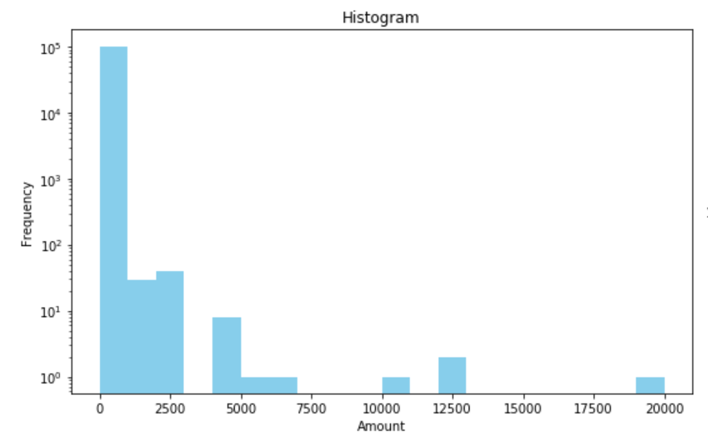
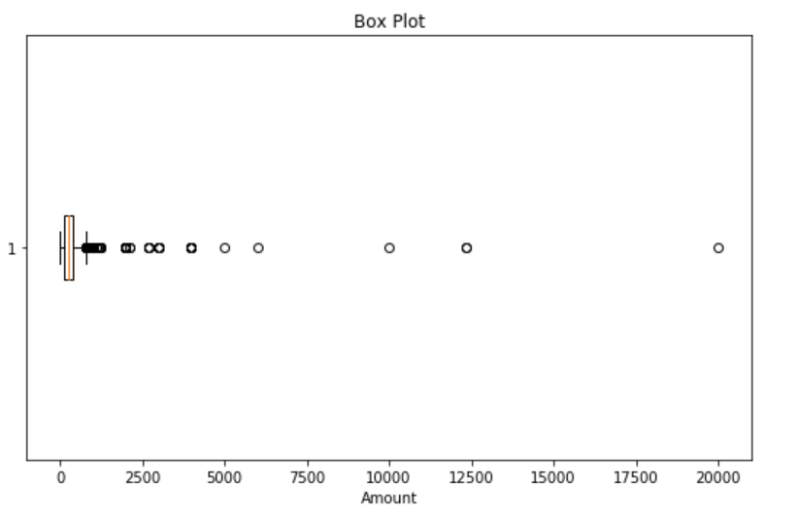
Univariate Analysis
Amount
Skewness – 14.434
Kurtosis – 1034.274
Right-Skewed
Maximum Amount – 20000.0
Minimum Amount – 0.0
No null values
Cleansing:
Outliers

Slide 10
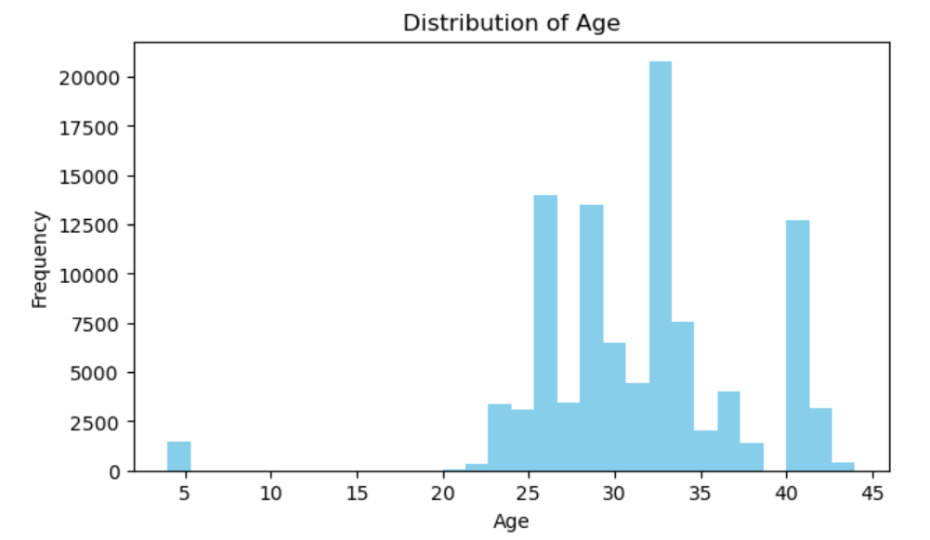
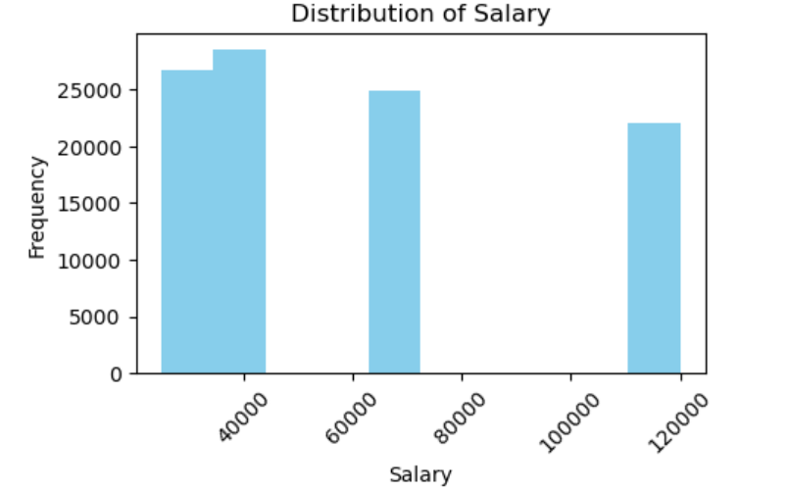
Customer Demographics
Date of Birth
Extracting Age
Max Age – 45
Min Age – 4
Most of the customers have their age as 33
Salary
Skewness: 0.155
Kurtosis: -5.111
No Null Values

Slide 11
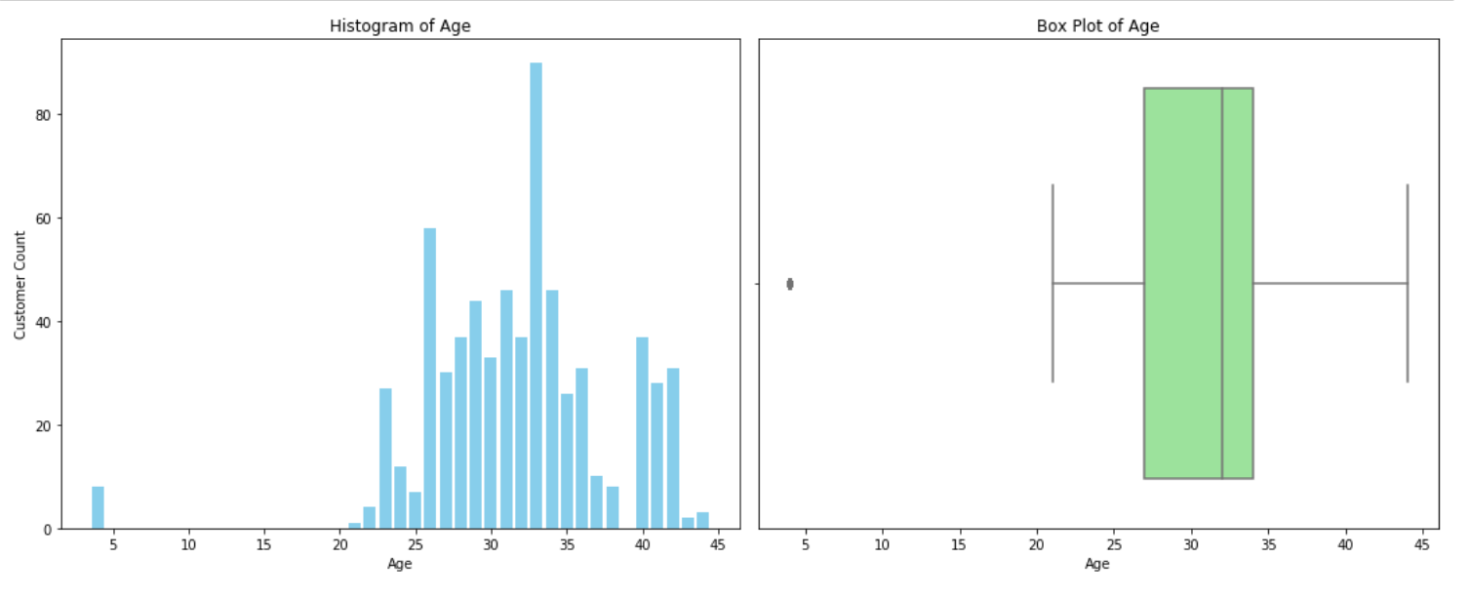
Customer Demographics and Behavior
Age Distribution and Service Customization
Insight: The age distribution is right-skewed, indicating a larger presence of older customers.
Business Action: Develop specialized financial products such as retirement plans or investment services tailored to older demographics.

Slide 12
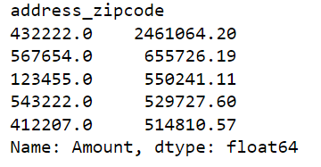
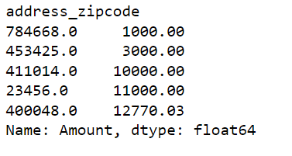
Transaction Patterns and Preferences
Zip Code Analysis
Insight: Certain zip codes exhibit significantly higher transaction amounts.
Business Strategy: Implement targeted promotional campaigns in these zip codes to capitalize on high transaction potential.

Slide 13
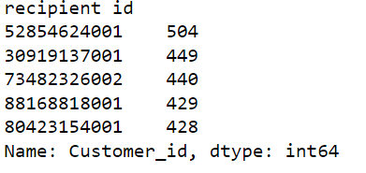
Customer-Recipient Relationship
Number of Recipients per Customer
Insight: On average, each customer interacts with 1.4 recipients.
Opportunity: Develop initiatives to increase recipient interactions, which can lead to diversified transaction activities.
Recipient-Recipient Interaction
Insight: There are 1,355 recipients in total, with an average of 75 transactions per recipient.
Some recipients are involved in transactions across multiple zip codes.
Strategy: Explore partnership opportunities with these recipients to offer specialized services or promotions.

Slide 14
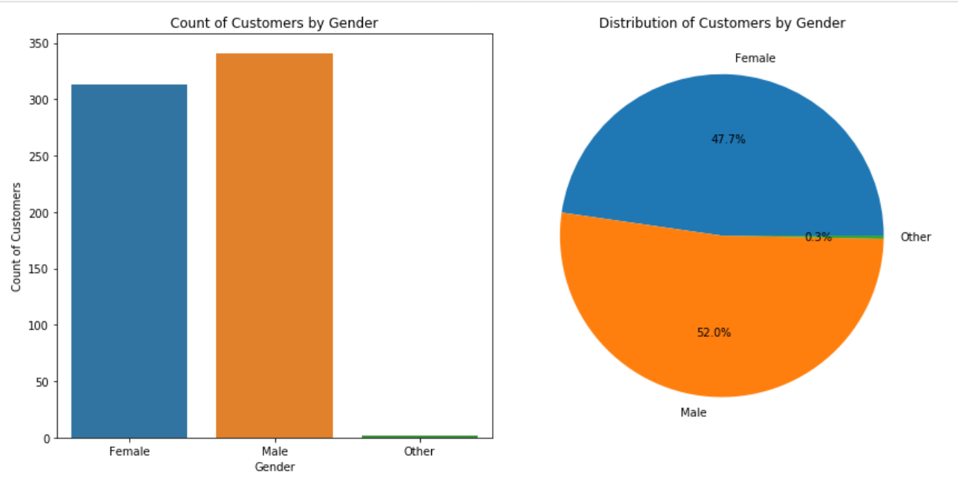
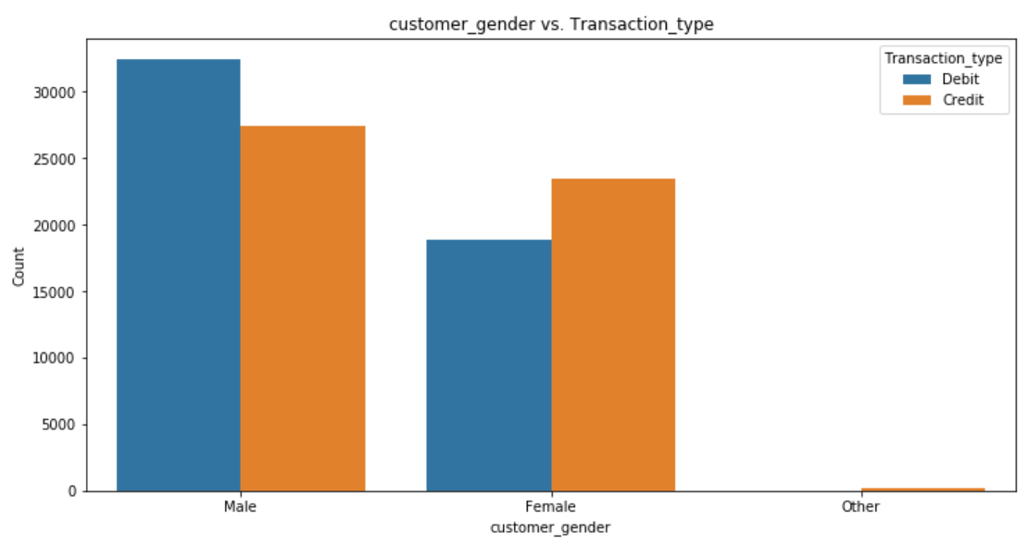
Customer Demographics and Behavior
Gender Distribution and Transaction Preferences
Insight: The dataset comprises a slightly higher proportion of male customers (52%) compared to female customers (48%).
Male customers tend to conduct more debit transactions, while female customers show a preference for credit transactions.
Business Opportunity: Targeted promotions can encourage more Female customers and other gender customers.

Slide 15
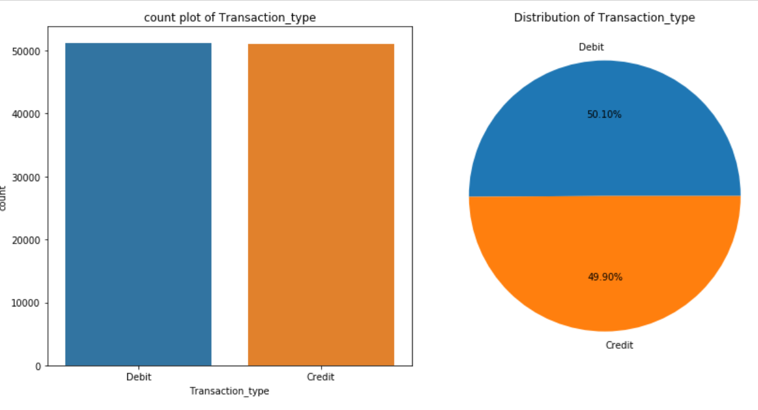
Transaction Patterns and Preferences
Transaction Type Distribution
Insight: Debit transactions slightly outnumber credit transactions.
Opportunity: Promotional incentives can be targeted towards increasing credit transactions to balance transaction types.

Slide 16
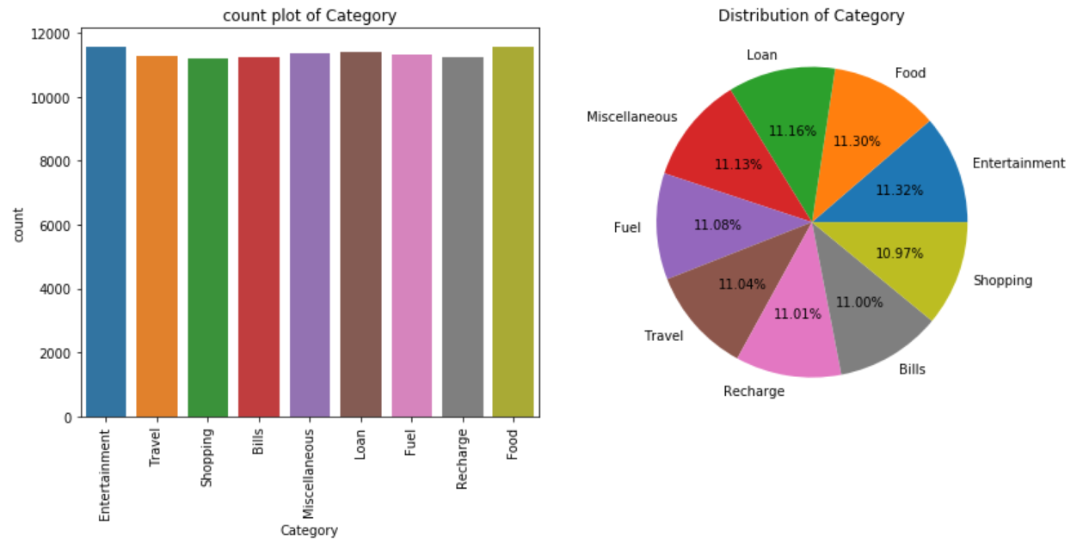
Transaction Patterns and Preferences
Preferred Transaction Categories
Insight: Entertainment, Food, and Loans are the top transaction categories.
Strategy: Forge partnerships with businesses in these categories to offer exclusive deals or loyalty rewards.

Slide 17
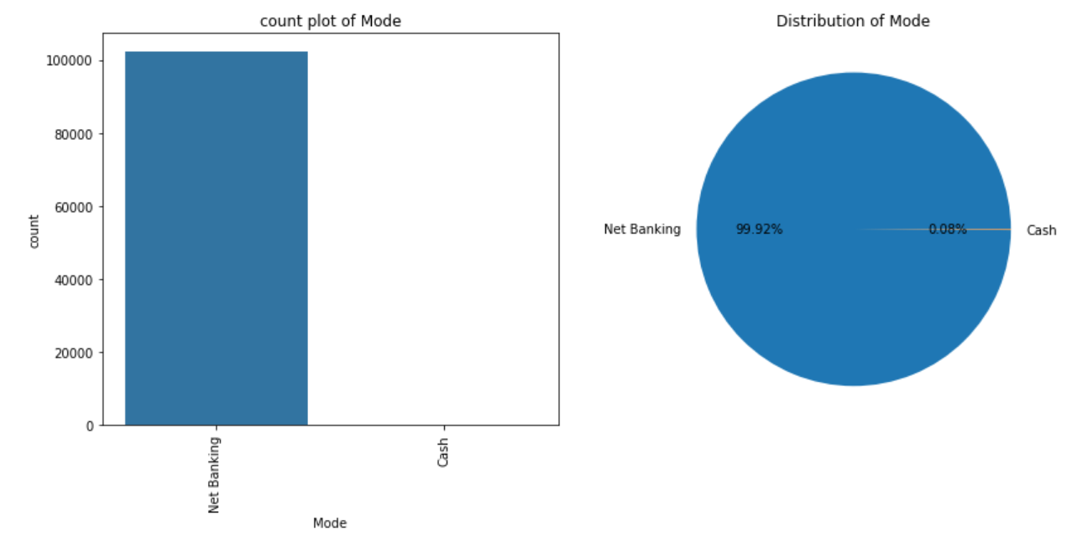
Transaction Patterns and Preferences
Mode of Transaction
Insight: Net Banking is the primary mode of transaction.
Action: Enhance digital banking services and user interfaces to cater to this preferred mode of transaction.

Slide 18
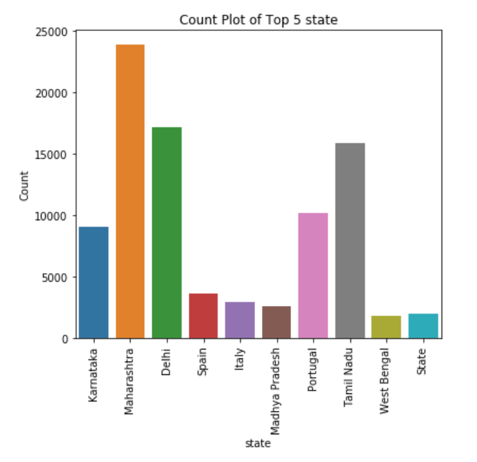
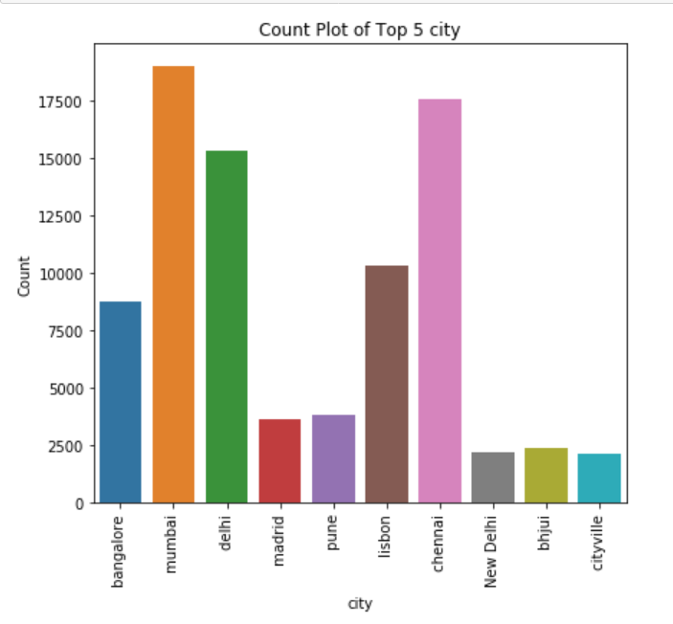
Geographic Analysis
1. State and City Insights
Insight: There are 41 states and 55 cities in the dataset.
Maharashtra, Delhi, and Tamil Nadu are key states with high transaction volumes.
Expansion Potential: Invest in localized marketing campaigns and customer acquisition strategies in these regions to capture more market share.

Slide 19
Statistical Insights and Business Strategy
1. Correlation Analysis
Insight: Strong correlations exist between transaction types and geographic locations.
Actionable Insight: Utilize geographic insights to tailor marketing strategies and product offerings based on regional preferences.
2. Gender and Transaction Type
Insight: Gender influences transaction preferences, with males favoring debit transactions and females showing a preference for credit transactions.
Strategy: Develop gender-specific marketing campaigns to maximize transaction conversions.
3. Age and Transaction Behavior
Insight: Different age demographics exhibit distinct transaction behaviors.
Business Approach: Segment marketing strategies to cater to the transaction preferences of specific age groups.

Slide 20
Business Recommendations:
Customer Engagement:
Target older customers with tailored financial products or services based on their transaction behavior.
Focus on improving customer experience for Net Banking transactions, which are the most preferred mode.
Marketing Strategy:
Leverage transaction category insights (e.g., Entertainment, Food) for targeted marketing campaigns.
Prioritize states and cities with high transaction volumes for localized marketing efforts.
Risk Management:
Implement robust fraud detection systems, especially for customers making unusually high-value transactions.
Monitor transaction patterns across demographics to identify potential compliance risks.

Slide 21
Business Recommendations:
Operational Efficiency:
Streamline processes based on peak transaction periods (e.g., March) to ensure optimal service levels.
Optimize resources based on geographic transaction trends to enhance operational efficiency.
Customer Segmentation:
Use demographic insights to segment customers for personalized offerings and loyalty programs.
Explore opportunities to increase the number of accounts per customer by providing tailored account packages.

Slide 22
Transformation and Cleansing rules:
Duplicate Removal:
Rule: Identify and remove duplicate rows from the DataFrame based on all columns.
Address Cleaning
Rules:
Remove special characters and symbols from the address column.
Replace consecutive dashes at the beginning with a single dash.
Data Transformation
Rules:
Create a new column (Recipient_id_str) from Recipient_id containing only string values.
Concatenate Address_state_address_City_address_Street with Recipient_id_str into a new column (New_address).
Clean Recipient_id by keeping only numeric values.
Replace null values in Recipient_id with corresponding values from the Duplicate column.
Split New_address into separate columns for State, City, and Street.
Handle non-standard representations of null values and empty strings.

Slide 23
Transformation and Cleansing rules:
Data Type Conversion:
Rules:
Convert date/time columns (Date_of_birth, Transaction_time, Date_of_Creation) to TimestampType with timezone.
Encoding:
Rule: Standardize gender values (F, M) to full labels (Female, Male) in the Customer_gender column.
String Capitalization:
Rule: Capitalize string values in all string columns except for Transaction_id.
Missing Value Imputation:
Rules:
Fill missing string values with the mode (most frequent value) for each string column.
Fill missing numeric values with the mean for each numeric column.

Slide 24
Transformation and Cleansing rules:
Missing Timestamp Imputation:
Rule: Fill missing timestamp values in timestamp columns with the oldest valid timestamp value.
Outlier Detection and Treatment:
Rules:
Identify outliers in numeric columns based on mean and standard deviation.
Treat outliers by capping them at lower or upper bounds defined by mean and standard deviation.
Saving Processed Data:
Rule: Write the processed DataFrame to HDFS in CSV format with a single output file.

Slide 25
Thank You

